Slide 1
All About Me
Presenter: Portia Amoshia
Class: ITEC 1001

Slide 2
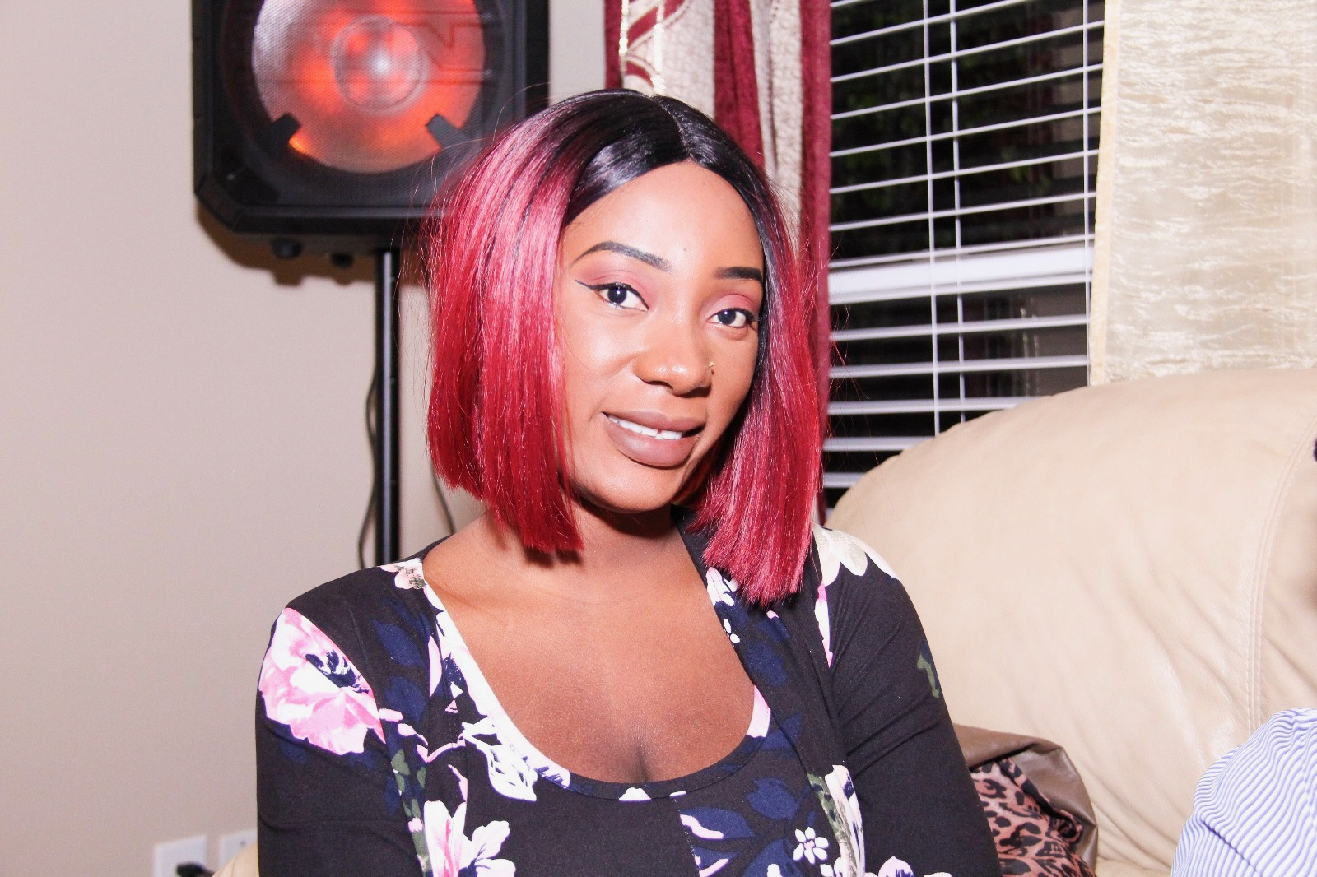
Intro
I like to eat Pizza
I play soccer when am bored
My favorite show is Shameless
I like the color Pink

Slide 3
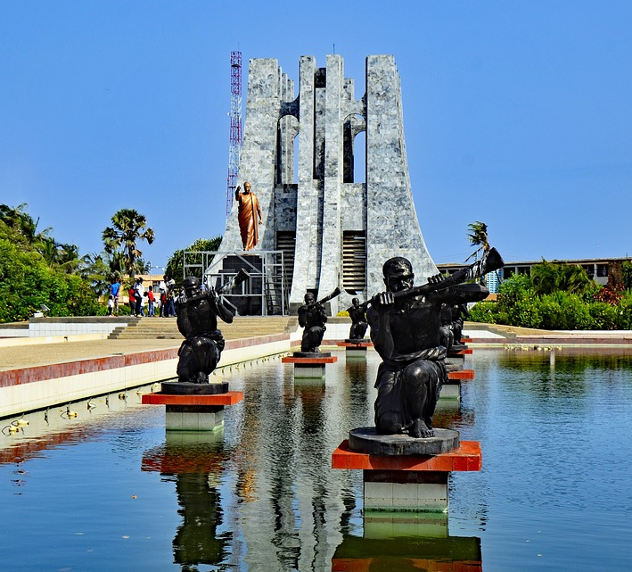
Point of origin
Am from Ghana
Accra to be specific

Slide 4
School
I went to Anson Highschool
I am a nursing major

Slide 5
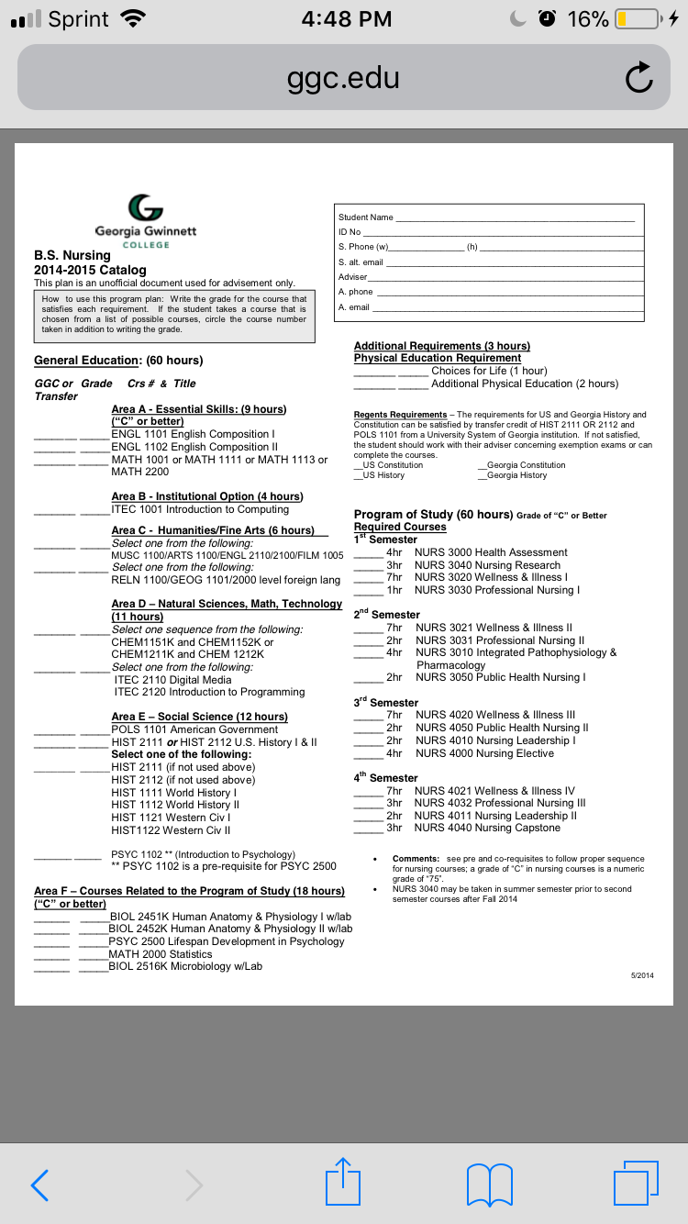
Program Plan

Slide 6
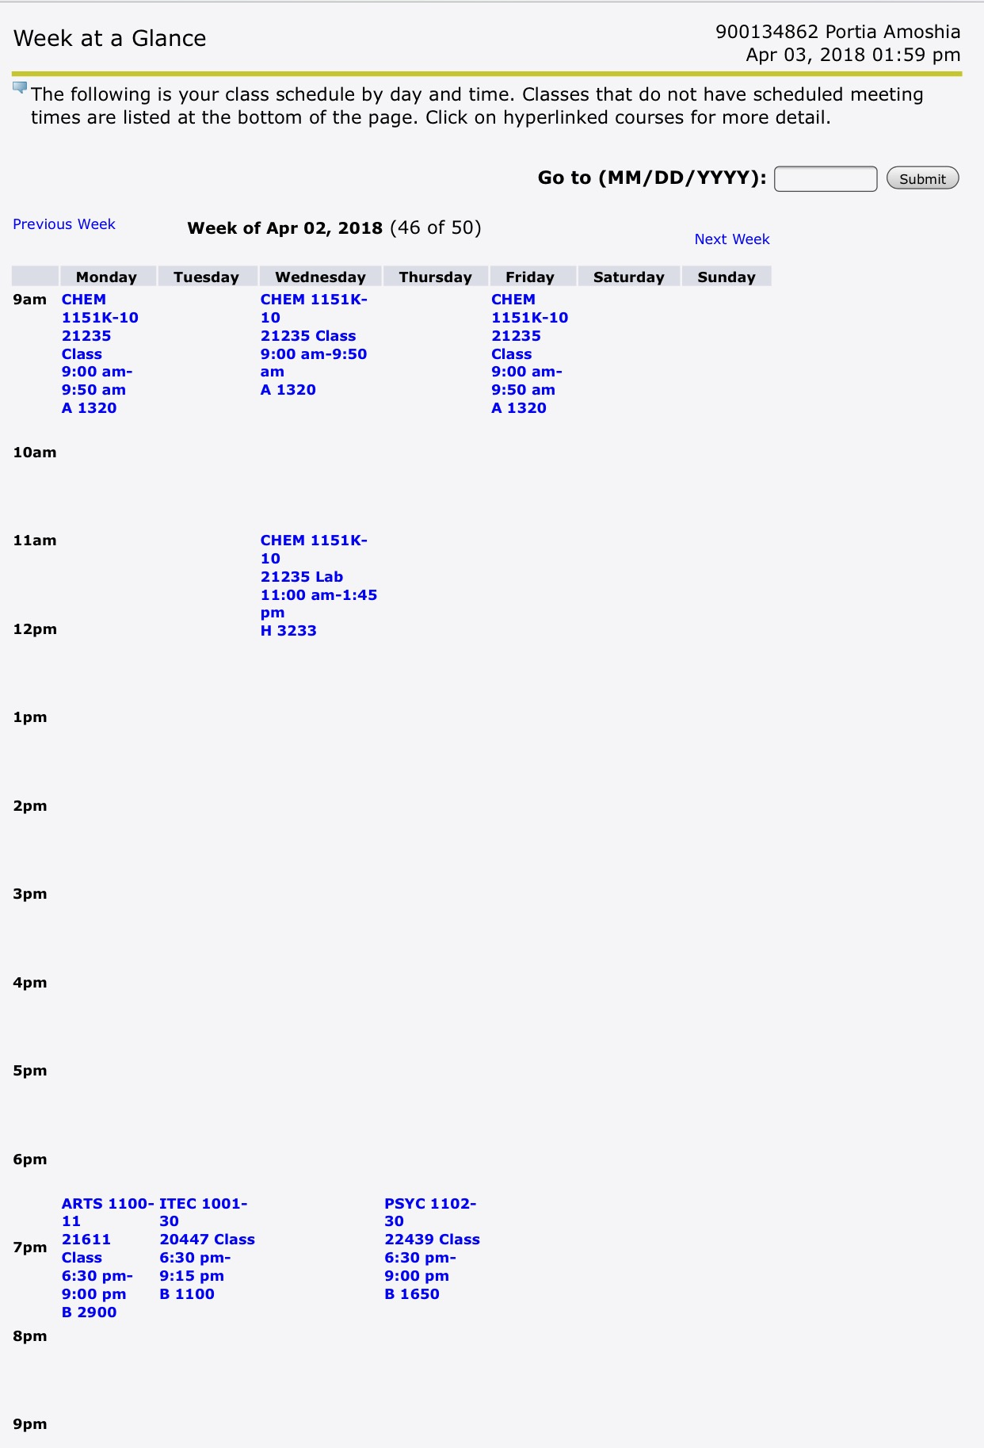
Spring 2018 Schedule
I attend classes three times a week
I take
Chemistry and Lab
Art Appreciation
Psychology
ITEC 1001

Slide 7
Fall 2018 Schedule
Am taking these classes next semester
Nutrition in Health and Exercise
Biomechanics
Epidemiology and Physical activity
Community Wellness

Slide 8
Job Titles
Registered nurse
Travel Registered nurse
Charge nurse
Admissions nurse
Licensed Practical nurse (LPN)

Slide 9
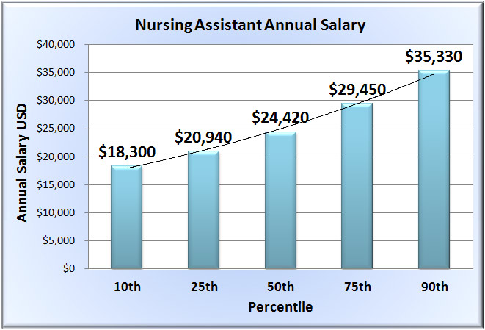
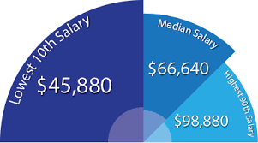
Salary Information
Nursing salary based on a profession
Nursing Salary In it’s percentile

Slide 10




Hobbies
I watch Netflix
I dance
I engage in physical activities

Slide 11
Conclusion
Applications learned
Making transitions
Learning how to Run presentations, by using the reverse timings
Creating Animations
What I liked the most, was learning how to use PowerPoint. It taught me new ways to be creative.

